Slide 1

LIVE SESSION 03
Designing the Study Before Writing Code
What exact tests should your thesis run and why? Research questions · baselines · fair experiments · useful evidence.
Md. Sabbir Ahmed · AI/ML Thesis Track · Phitron

Slide 2





CONTINUITY
Where This Session Fits
Session 1
Choose feasible topic directions — moving from broad interests to candidate topics and dataset thinking.
Session 2
Use papers to decide — search, screen, track, and synthesise research gaps.
Session 3
Design the study — plan questions, baselines, experiments, metrics, and risks.
A selected topic is not enough. A thesis needs a clear, testable plan.

Slide 3
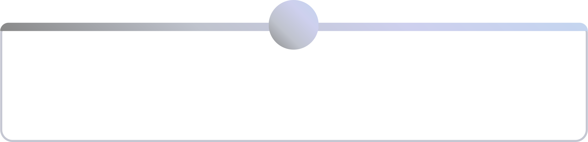
OUTCOMES
What You Should Leave With Today
1
2
Research Questions
Evidence Plan
Clear questions that experiments can actually answer.
What result would answer each question.
3
4
Baselines
Fair Protocol
What your new work should be compared against.
How to split data and avoid accidental cheating.
5
6
Right Metrics
Experiment Matrix
Measures that match the real-world problem.
One table linking RQ, data, method, metric, and evidence.
Core idea: Your code should follow your research questions — not the other way around.

Slide 4
BIG IDEA
The Common Mistake: Jumping Into Coding
❌ Weak Path
✅ Better Path
If you want to know which route reaches campus faster, you don't just drive randomly. You compare the same starting point, the same time window, and the same traffic condition.
Find a dataset
Train a model
Try many models
Pick best accuracy
Write the story later
Write the question
Decide evidence needed
Choose fair baselines
Plan test rules
Then code
An experiment is only useful when the comparison is fair. Structure your thinking before you touch a single line of code.

Slide 5

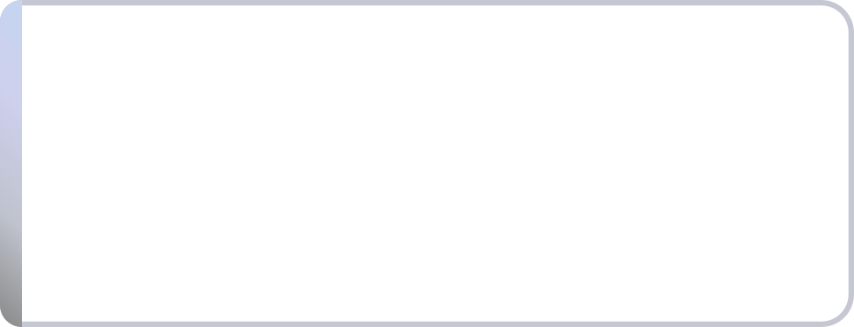

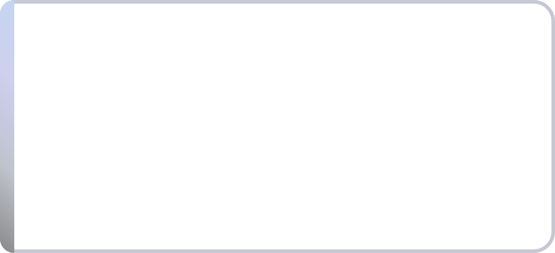
RESEARCH QUESTIONS
Start From the Gap, Then Ask the Question
RQ 1
How much does performance drop under each field-like condition?
Example gap: Existing plant-disease studies report high accuracy on clean images — but it is unclear whether models work on messy field photos taken by farmers.
RQ 2
Which model keeps the most stable class-wise performance?
Main RQ: How robust are plant-disease classifiers when images contain poor light, blur, background clutter, or partial leaves?
RQ 3
Which disease classes fail most often under messy image conditions?

Slide 6
RESEARCH QUESTIONS
Bad Research Questions Lead to Weak Experiments
Problem
Weak RQ
Better RQ
Too broad
Can AI detect fake news?
How well can Bangla and code-mixed posts be classified as misinformation using text features?
Method-first
Can we use CNN for plant disease?
How does performance change when plant images include blur, poor light, and clutter?
Accuracy-only
Which model gives highest accuracy?
Which model performs best for the minority class using recall and F1?
Unclear claim
Can XAI improve phishing detection?
Which message cues influence predictions, and are they meaningful to users?
A good RQ can be answered with data, tests, and clear evidence.

Slide 7






RESEARCH QUESTIONS
Common RQ Types for AI/ML Theses
Performance
Comparison
Can it detect or predict the target? e.g., phishing message detection
Which method is better under the same rules? e.g., SVM vs transformer
Robustness
Subgroup
Does it work when data gets messy? e.g., plant images with bad lighting
Does it work equally across groups? e.g., different scam categories
Explanation
Efficiency
Can we understand why it predicts? e.g., which words trigger phishing labels
Can it run with limited resources? e.g., model on low-end phones
Pick only the RQ types your gap really needs. More questions do not mean a better thesis.

Slide 8

EVIDENCE PLAN
Every RQ Creates an Evidence Duty
RQ Asks...
Evidence Needed
Does the model detect at-risk students early?
Week 1–5 data, test labels, recall for at-risk group
Does code-mixing hurt phishing detection?
Separate Bangla and code-mixed test groups
Does the model work on field images?
Clean vs. messy image test sets
Are explanations meaningful?
Example explanations checked by users or domain experts
Can it run on limited devices?
Model size, prediction time, and memory usage
If you cannot say what evidence will answer the RQ, the RQ is not ready.

Slide 9

BASELINES
Baselines: Who Are You Competing Against?
Think of a baseline like a fair opponent. If your new approach only beats a very weak opponent, the result is not impressive.
1. Simple Baseline
2. Standard Baseline
Majority class, simple rules, or a traditional model. e.g., always predict "not phishing."
Common method from nearby papers. e.g., TF-IDF + SVM for text classification.
3. Strong Baseline
A competitive recent method suited to the task. e.g., BanglaBERT or multilingual BERT.

Slide 10
BASELINES
Baseline Examples by Thesis Type
Bangla Text Classification
Plant Disease Images
Student Risk Prediction
Health Tabular Prediction
Majority class
TF-IDF + logistic regression
SVM
Transformer model
Simple CNN
Pretrained ResNet
MobileNet (lightweight)
Proposed robustness setup
Logistic regression
Decision tree
Random forest
Gradient boosting
Logistic regression
Naive Bayes
Random forest
XGBoost or LightGBM
Do not compare many models just to make a table look large. Compare models for a reason.

Slide 11

FAIR TEST
Fair Experiments Use the Same Rules
Same train, validation, and test split
Same preprocessing where possible
Same test set for all models
You cannot compare two restaurants if one gets a full kitchen and the other gets only a stove. In ML, unfair preprocessing or tuning can make one model look better for the wrong reason.
Same metric and reporting style
If the test setup is unfair, the best-looking result is not trustworthy.
Similar tuning effort for each model
Fixed random seed where possible

Slide 12
FAIR TEST
Data Splitting: Decide Before You See Results
Split Type
Useful When
Risk to Check
Random split
Good for many simple datasets
Can fail when duplicates or related users exist
K-fold cross-validation
Useful when data is small
Must avoid leakage across folds
User-level split
For posts, students, or patients
Same person must not appear in train and test
Time-based split
For early prediction or time-sensitive events
Train on past, test on future only
External test set
Best for measuring generalisation
Needs a second independent dataset or source

Slide 13

FAIR TEST
Leakage: Accidental Cheating
Student Risk
Medical Data
Using final exam marks to predict early risk
Same patient appears in both training and testing
Leakage means the model gets hidden hints from the test answer. The score looks good but the study is fundamentally compromised.
Images
Social Media
Original image in training, augmented copy in testing
Duplicate posts appear in both splits
Strong students prevent leakage before training starts and not after noticing suspiciously high accuracy.
Preprocessing
Normalising using the full dataset before splitting

Slide 14


EVALUATION
Metrics Should Match the Real Problem
The Accuracy Trap
If 95 of 100 messages are safe, a model can reach 95% accuracy by calling everything safe and miss every single phishing message.
Better Thinking
Ask what mistake is costly. Missing a scam is dangerous. Missing an at-risk student is serious. A wrong disease class may lead to the wrong treatment.
Choose Metrics First
Decide the main metric before you know which model wins otherwise you may keep changing the story until one model looks best.
The metric is not decoration. It defines what "good" actually means.

Slide 15

EVALUATION
Metric Examples by Thesis Type
Imbalanced Classification
Balanced Classification
Recall, precision, F1, confusion matrix
Phishing, rare disease, at-risk students
Accuracy + class-wise breakdown
Clean multi-class image datasets
Regression
Ranking / Recommendation
MAE, RMSE, R², residual analysis
Crop yield or price prediction
Precision@K, Recall@K, NDCG
Recommending learning resources
Deployment Claim
Explanation Claim
Inference time, model size, memory
Phone-based plant detection
Expert inspection or user feedback
Why a message is flagged as phishing

Slide 16





DEEPER ANALYSIS
A Stronger Thesis Needs More Than One Score
Error Analysis
Ablation
Robustness
Where does the model fail? Group wrong predictions and identify failure patterns.
Which part actually helps? Remove one feature or module and compare the outcome.
Does it survive messy data? Test blur, slang, missing values, or noisy text.
Subgroup Analysis
External Validation
Who gets worse results? Compare by class, source, language, or user group.
Does it work outside the original data? Test on another source or time period.
Choose deeper analysis only when it connects directly to your research question.

Slide 17

DEEPER ANALYSIS
Error Analysis: Learn From Wrong Answers
Example: Bangla Phishing Detector
Wrong Prediction
Likely Reason
What to Report
Scam marked safe
Message looks like a real delivery notification
Model misses local brand-style wording
Safe marked scam
Contains words like OTP or account
Model overreacts to security-related words
Code-mixed message failed
Bangla-English spelling variation
Need better handling of code-mixed text
Scholarship scam failed
Rare category in training data
Need category-wise recall reported
A thesis becomes stronger when it explains failure, not just celebrates success.

Slide 18

EXPERIMENT MATRIX
The Experiment Matrix Keeps Everything Connected
Research Question
Experiment
Data
Baselines
Metric
Extra Analysis
Does code-mixing reduce detection?
Evaluate subgroups
Bangla and code-mixed messages
SVM, transformer
F1, recall
Error analysis by language type
Does blur hurt disease detection?
Clean vs. blurred images
Plant images with blur levels
CNN, MobileNet
Class-wise F1
Robustness curve
If an experiment does not answer an RQ, remove it. If an RQ has no experiment, rewrite it.

Slide 19

EXPERIMENT MATRIX
Filled Example: Early Programming-Risk Thesis
Gap: Teachers often notice struggling programming students too late. Existing work may not use early lab behaviour clearly enough for Week 5 support.
RQ
Experiment
Data & Split
Metric
Extra Check
Can risk be predicted by Week 5?
Train early-risk models
Attendance, lab delay, quiz — Week 1–5 only
At-risk recall, F1
Avoid final exam leakage
Which early signals matter most?
Feature importance & ablation
Remove one signal at a time
F1 change
Does lab delay matter?
Where does the model fail?
Error analysis
False safe and false risk cases
Confusion matrix
Check if low-attendance cases dominate
This is now a study plan, not just a topic title.

Slide 20



REPRODUCIBILITY
Make the Work Repeatable
Data
Code
Preprocessing
Source, size, labels, licence, split, and missing values
Notebook or scripts, package versions, random seed
Cleaning rules, encoding, augmentation, tokenisation
Models
Results
Hyperparameters, training time, and hardware used
All metrics reported and not only the best number
A recipe without exact ingredients and steps cannot be repeated. A thesis without split details, preprocessing rules, code settings, and full metrics has the same problem.

